Slide 1

Smart Music Teacher
CJC2302
Christy CHENG Tsz Ying (1155157686)
Hugo CHEUNG Chi Wang (1155158048)

Slide 2
Table of contents
01.
Introduction
02.
Performance Analysis
03.
Emotion Analysis
04.
Piece Analysis
05.
Web Application
06.
Conclusion
Project Overview
Improvement
Integrate to App
Random Forest
Musical Feature
Spectrogram
CNN Model
Architecture
Demonstration
Insights
Introduction | Performance Analysis | Emotion Analysis | Piece Analysis | Web Application | Conclusion

Slide 3
01.
Introduction

Slide 4
Project Overview
Python App
Web Application
Performance Analysis
Emotion Analysis
Piece Analysis
Piano Practice Video
Music Video/Audio
Piano Piece
Performance Transcription
Valence-Arousal Analysis
Music Era Classification
Musical Analysis
Music Era Transfer
Metrics
Piano Fingering Suggestion
Introduction | Performance Analysis | Emotion Analysis | Piece Analysis | Web Application | Conclusion

Slide 5
02.
Performance Analysis

Slide 6
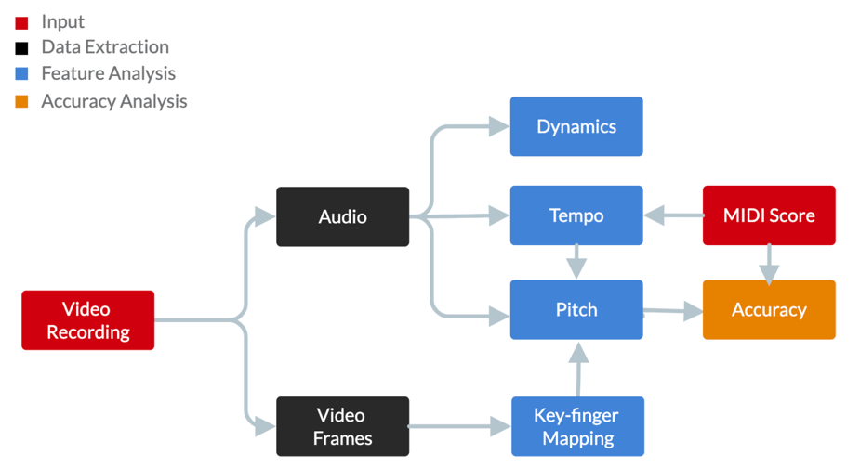
Introduction
Flow Chart of Term 1 Implementation
Introduction | Performance Analysis | Emotion Analysis | Piece Analysis | Web Application | Conclusion

Slide 7
Major Improvements
Tempo Detection
Auto-thresholding
Dynamic Tempo Detection
Pitch Detection
Auto-thresholding
Windowing Method
Introduction | Performance Analysis | Emotion Analysis | Piece Analysis | Web Application | Conclusion

Slide 8
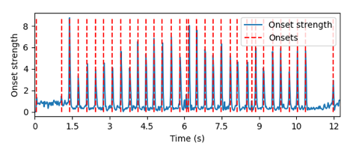
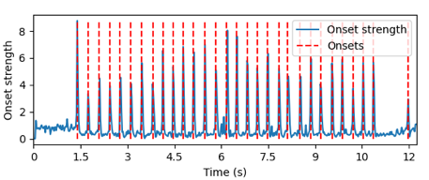
Improvements - Tempo
Thresholding in Term 1
A constant threshold was adopted
Possible in leading to false filtering of useful content
Manual adjustment was needed
Thresholding in Term 2
Dynamically search for a threshold by slowly decreasing the threshold
Cater to any input with various average onset strengths
Introduction | Performance Analysis | Emotion Analysis | Piece Analysis | Web Application | Conclusion

Slide 9
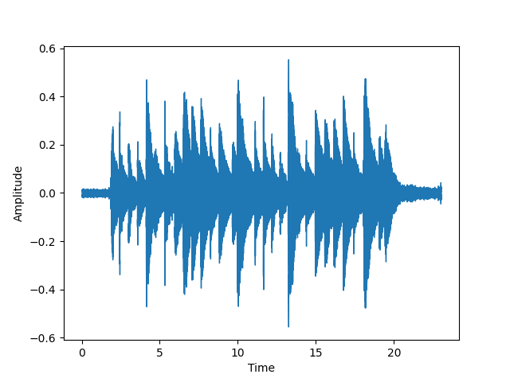
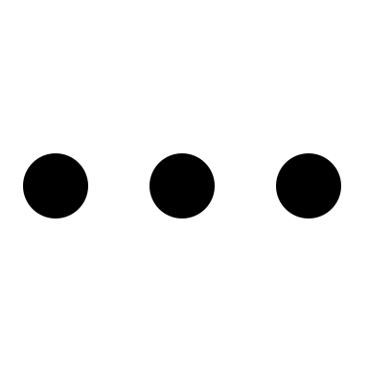
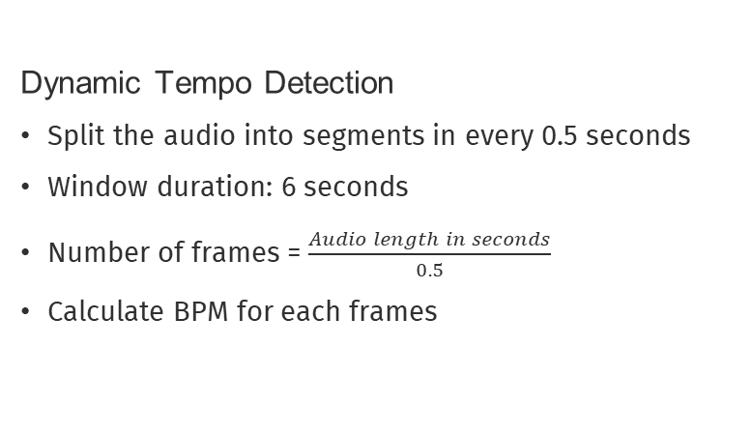
Improvements - Tempo
Dynamic Tempo Detection
Split the audio into segments in every 0.5 seconds
Window duration: 6 seconds
Number of frames = $\frac{Audio length in seconds}{0.5}$
Calculate BPM for each frames
Introduction | Performance Analysis | Emotion Analysis | Piece Analysis | Web Application | Conclusion

Slide 10
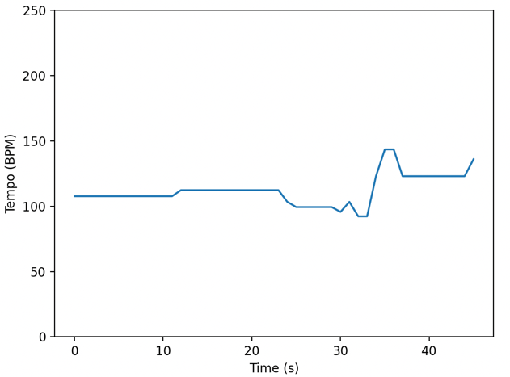
Improvements - Tempo
Dynamic Tempo Detection Sample Result
Introduction | Performance Analysis | Emotion Analysis | Piece Analysis | Web Application | Conclusion

Slide 11
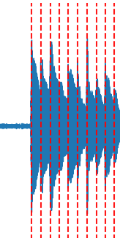
Improvements - Pitch
Windowing in Term 1
Split the audio into windows by a manual sampling rate and window width
Possible to have two onsets within a window
Windowing in Term 2
Referencing to the onset detection result
Manual sampling rate is not required
Introduction | Performance Analysis | Emotion Analysis | Piece Analysis | Web Application | Conclusion

Slide 12
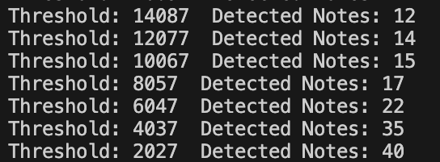
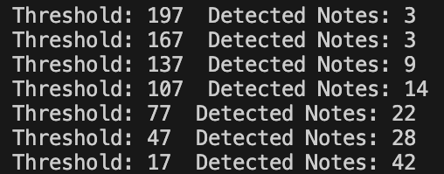
Improvements - Pitch
Magnitude thresholding in Term 1
Manual thresholding are needed
The average magnitude varies tremendously among different input
Magnitude thresholding in Term 2
Dynamic thresholding by referencing to the maximum magnitude of input
Customized threshold is not required
Sample with a large average magnitude
Sample with a small average magnitude
Introduction | Performance Analysis | Emotion Analysis | Piece Analysis | Web Application | Conclusion

Slide 13
Metrics
Scores out of 100 (easier to understand)
Pitch Accuracy
Transcription
Tempo Stability
Average
Overall Score
Analytics
Dynamic Consistency
Piano Fingering
Introduction | Performance Analysis | Emotion Analysis | Piece Analysis | Web Application | Conclusion
Notes:
main idea is to convert the complicated and technical analytics into scores that are simple and easy to understand
designed the four metrics

Slide 14
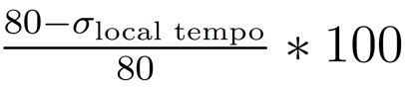
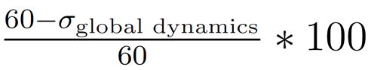
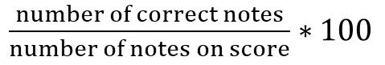
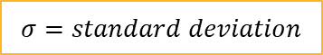
Metrics
Pitch Accuracy
$\frac{number of correct notes}{number of notes on score}∗100$
Tempo Stability
$$σ=standard deviation$$
Dynamic Consistency
Introduction | Performance Analysis | Emotion Analysis | Piece Analysis | Web Application | Conclusion
Notes:
main idea is to convert the complicated and technical analytics into scores that are simple and easy to understand

Slide 15
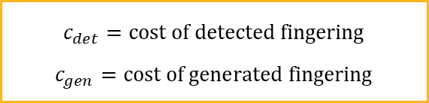
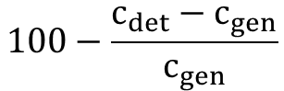
Metrics
Piano Fingering Cost Function
13 arbitrary rules (by Parncutt et al. [1])
designed for monophonic music
Piano Fingering Score
generate fingerings based on transcription
→ compare with cost of detected fingerings
higher detected cost → lower score
“vertical” and “horizontal” cost (by Kasimi et al. [2])
proposed polyphonic cost rules
$$100−\frac{c_{det}−c_{gen}}{c_{gen}}$$
Vertical Cost
pairwise maximum cost + weak finger rule
$$c_{det}=cost of detected fingering$$
$$c_{gen}=cost of generated fingering$$
Horizontal Cost
two-chord transition: pairwise maximum cost
three-chord transition: cost using lowest pitch only
Introduction | Performance Analysis | Emotion Analysis | Piece Analysis | Web Application | Conclusion
Notes:
finger span, key colour, finger strength, hand position change
highlight we modified into polyphonic version

Slide 16
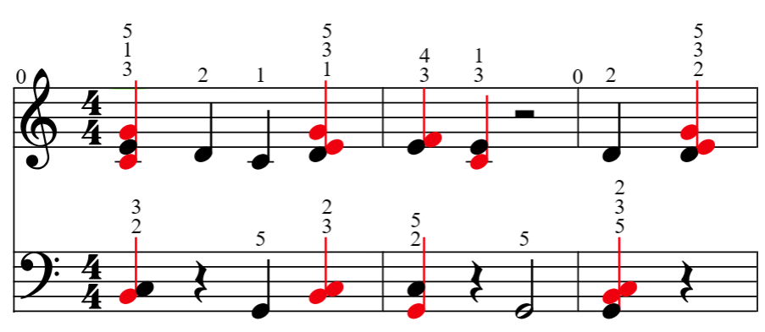
Presentation - Performance Transcript
Pitch Detection
Wrong Notes Highlighting
Piano Fingering + L/R Separation
Introduction | Performance Analysis | Emotion Analysis | Piece Analysis | Web Application | Conclusion

Slide 17
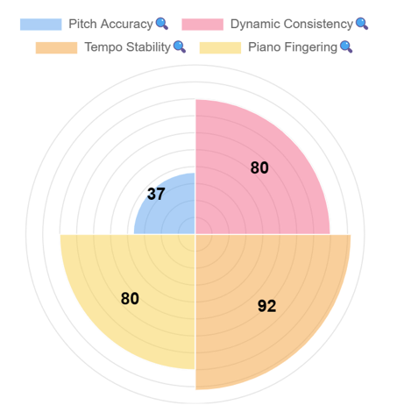
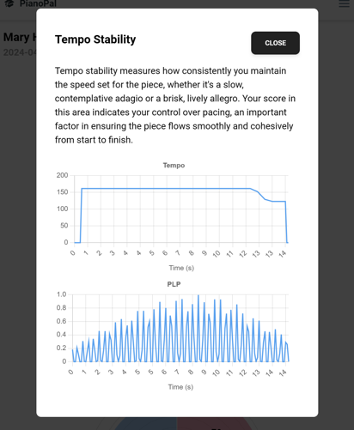
Presentation - Metrics
Metrics: Polar Area Chart
Detailed Analytics: Pop-up Window
Text Explanation
Technical Graphs
Library: Chart.js
Introduction | Performance Analysis | Emotion Analysis | Piece Analysis | Web Application | Conclusion

Slide 18
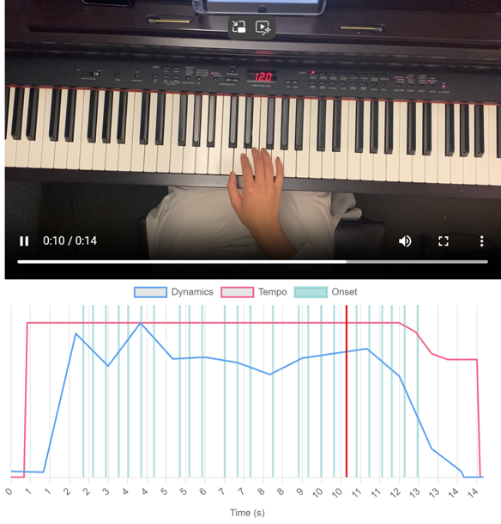
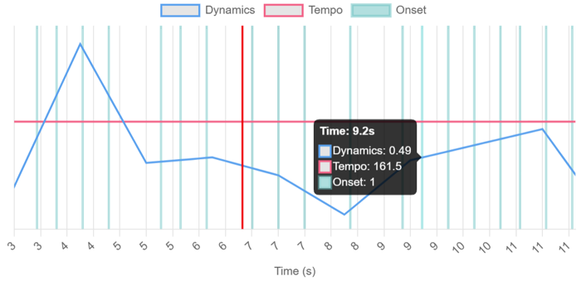
Presentation - Analytics
Multi-line Chart
Show multiple analytics on same time scale
Synchronized playback with video
Zoom-in and display details on hover
Implementation: React Video Player Callback + Chart.js
Introduction | Performance Analysis | Emotion Analysis | Piece Analysis | Web Application | Conclusion

Slide 19
03.
Emotion Analysis

Slide 20
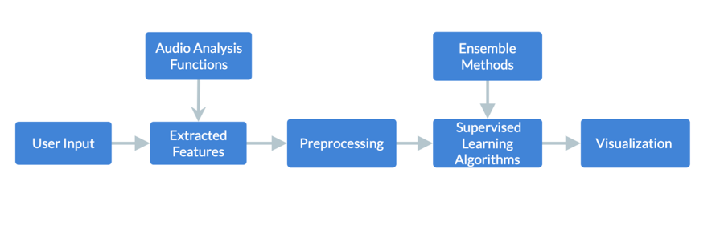
Emotion Analysis
Emotion in Music = Feeling the performer express + Feeling the audience perceive
Highly subjective, affected by various factors
Example: Atmosphere, Personal experiences, Quality of instruments
Purpose
Classify the inputs into emotion categories by machine learning algorithm
Provide reference for the user in expressiveness using a more objective way
Flow Chart of Emotion Analysis
Introduction | Performance Analysis | Emotion Analysis | Piece Analysis | Web Application | Conclusion

Slide 21
Valence and Arousal
Valence and Arousal Framework by James A. Russel [3]
Understanding emotion in the dimension of valence and arousal
Describe and measure the emotion experiences of individuals
Valence
Pleasantness or unpleasantness
Positive valence:
Happiness, joy, contentment
Negative valence:
Sadness, anger, disgust
Arousal
Intensity or energy level
High arousal:
Excitement, fear, astonished
Low arousal:
Calm, relaxed, bored
Introduction | Performance Analysis | Emotion Analysis | Piece Analysis | Web Application | Conclusion

Slide 22
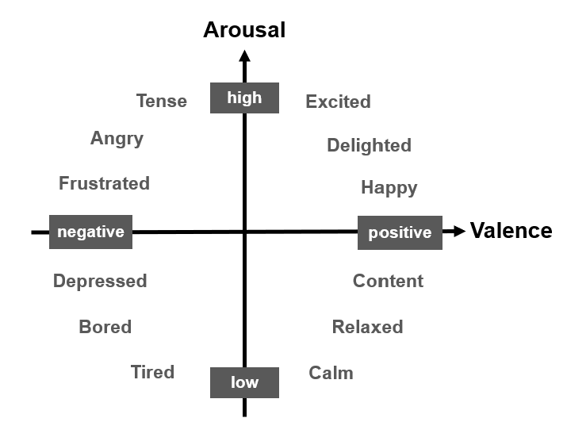
Valence and Arousal
The Valence-Arousal Graph
Introduction | Performance Analysis | Emotion Analysis | Piece Analysis | Web Application | Conclusion

Slide 23
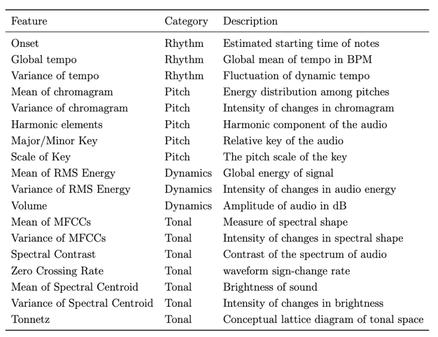
Feature extraction
Dataset description
4Q Audio Emotion Dataset [4][5]
900 MP3 songs labeled in four quadrants according to the valence and arousal model.
Feature extraction
18 audio features covering rhythm, pitch, dynamics, and tonal
Consideration of features extraction time
Introduction | Performance Analysis | Emotion Analysis | Piece Analysis | Web Application | Conclusion

Slide 24
Model
Ensemble supervised learning algorithm
Random Forest (RF), Support Vector Machine (SVM) , Gradient Boosting Decision Trees (GBDT)
Adopted the best model by comparing validation accuracy with hyperparameters finetuning
SVM
Find an optimized line to separate the class data points
RF
Multiple decision trees
Trees are uncorrelated
Bagging technique
GBDT
Multiple decision trees
Trees are correlated
Boosting technique
Introduction | Performance Analysis | Emotion Analysis | Piece Analysis | Web Application | Conclusion

Slide 25
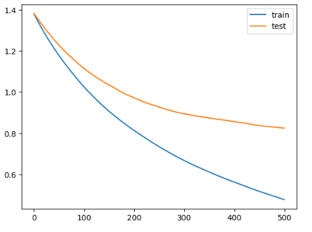
Results
Fine-tuning
Number of trees (RF, GBDT)
Maximum depth for each of the tree (RF)
Kernel shape (SVM)
Learning rate (GBDT)
Validation loss curve of the best GBDT model
Best result from each model
Random Forest (Number of trees = 50, Maximum depth = 10) → 69.70%
Support Vector Machine (Kernel = linear) → 53.03%
Gradient Boosting Decision Trees (Number of trees = 200, Learning rate = 0.005) → 71.21%
Introduction | Performance Analysis | Emotion Analysis | Piece Analysis | Web Application | Conclusion

Slide 26
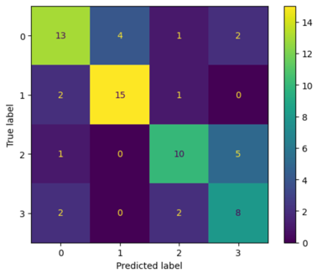
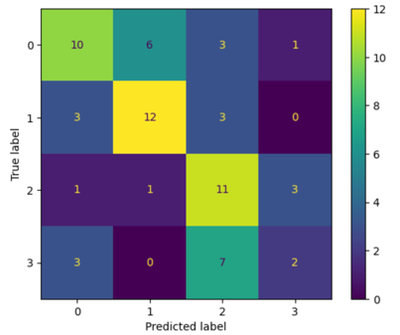
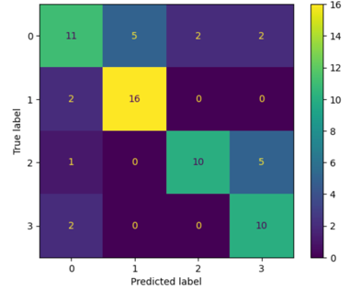
Results
Confusion Matrix of the best result from each models
Not very effective in classifying difference in valence
RF
SVM
GBDT
Introduction | Performance Analysis | Emotion Analysis | Piece Analysis | Web Application | Conclusion

Slide 27
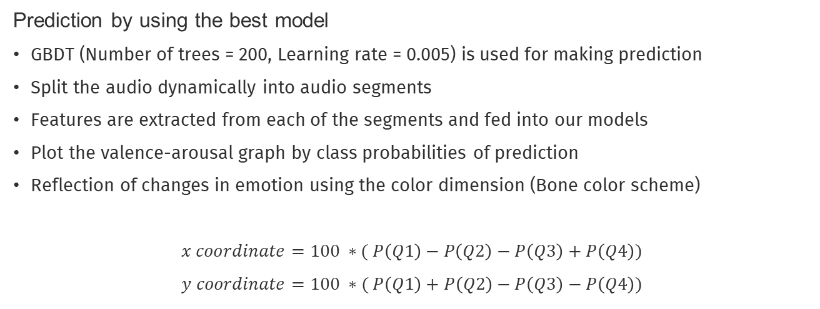
Prediction
Prediction by using the best model
GBDT (Number of trees = 200, Learning rate = 0.005) is used for making prediction
Split the audio dynamically into audio segments
Features are extracted from each of the segments and fed into our models
Plot the valence-arousal graph by class probabilities of prediction
Reflection of changes in emotion using the color dimension (Bone color scheme)
$$x coordinate=100 ∗( P\left(Q1\right)−P\left(Q2\right)−P\left(Q3\right)+P\left(Q4\right))$$
$$y coordinate=100 ∗( P\left(Q1\right)+P\left(Q2\right)−P\left(Q3\right)−P\left(Q4\right))$$
Introduction | Performance Analysis | Emotion Analysis | Piece Analysis | Web Application | Conclusion

Slide 28

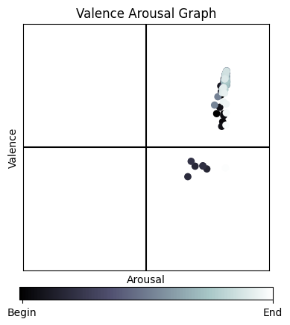
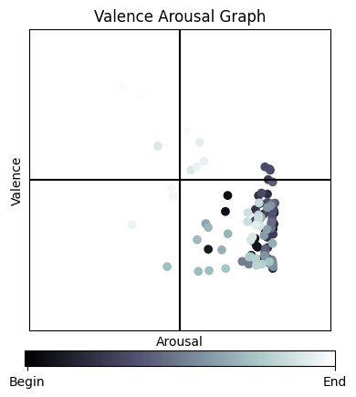
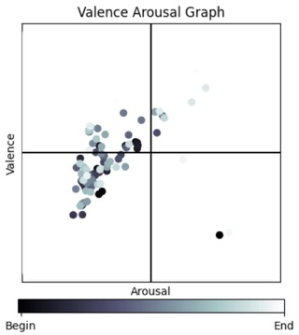
Prediction
Examples of the resulting graph
Canon in D
Minuet in D Minor
Moonlight Sonata 1st Movement
Introduction | Performance Analysis | Emotion Analysis | Piece Analysis | Web Application | Conclusion

Slide 29
04.
Piece Analysis

Slide 30
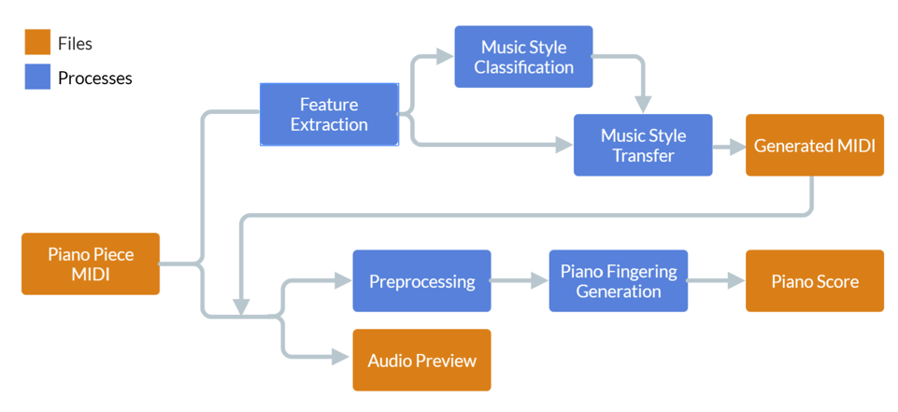
Introduction
Flow Chart of Piece Analysis functions
Introduction | Performance Analysis | Emotion Analysis | Piece Analysis | Web Application | Conclusion

Slide 31
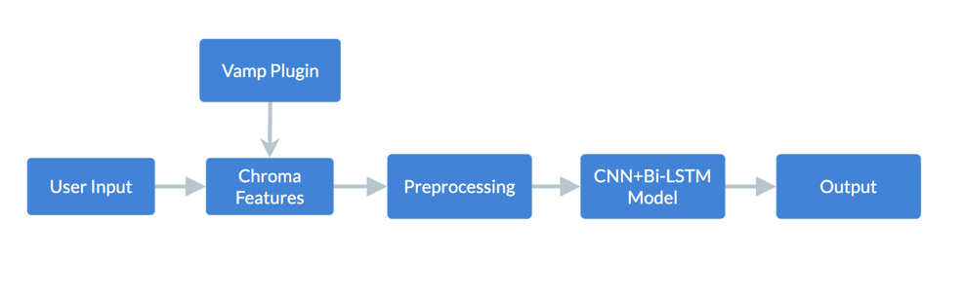
Style Classification
Music era is representing the style of the music in a certain time range in music history
Medieval, Renaissance, Baroque, Classical, Romantic, and 20th/21st Century (Modern)
Purpose
Classify the user’s input into classical music era using deep learning model
Scope of interest: Baroque, Classical, Romantic, and Modern era
Flow Chart of Style Classification
Introduction | Performance Analysis | Emotion Analysis | Piece Analysis | Web Application | Conclusion

Slide 32
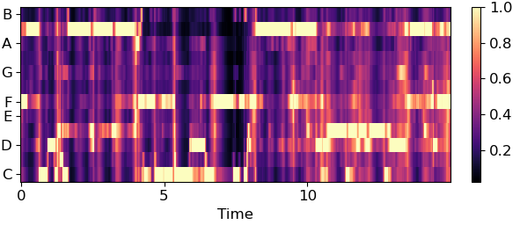
Feature extraction
Dataset description
Cross-era dataset [6]
Dynamic NNLS chroma features of 2000 tracks labeled with its corresponding music eras
NNLS chroma ensures the resulting chroma features are non-negative
Feature extraction
Chroma features are the intensity or energy of the 12 different semitone classes, from note A to note G#
With a sampling rate of 0.1, unify length of data into 100, representing 10 seconds of data
Introduction | Performance Analysis | Emotion Analysis | Piece Analysis | Web Application | Conclusion

Slide 33
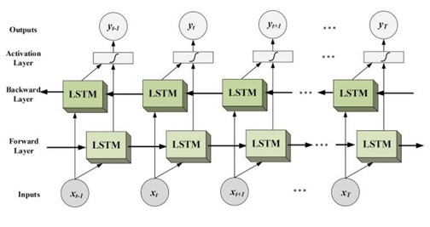
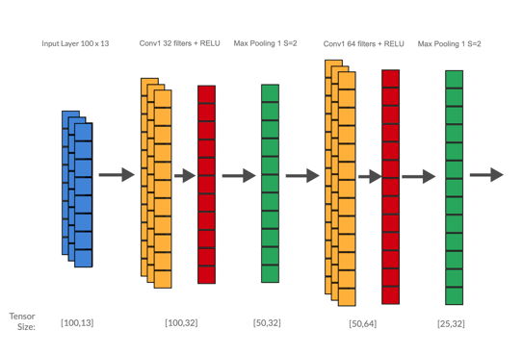
Model
Sequencing model approach
LSTM model preserves past information using memory cells
A Bi-LSTM consists of two layers of LSTM, in both forward and backward direction
→ Preserving both future and past information
Multi-modal approach
Combining CNN and Bi-LSTM model
Capturing both spatial features and temporal information
Introduction | Performance Analysis | Emotion Analysis | Piece Analysis | Web Application | Conclusion

Slide 34
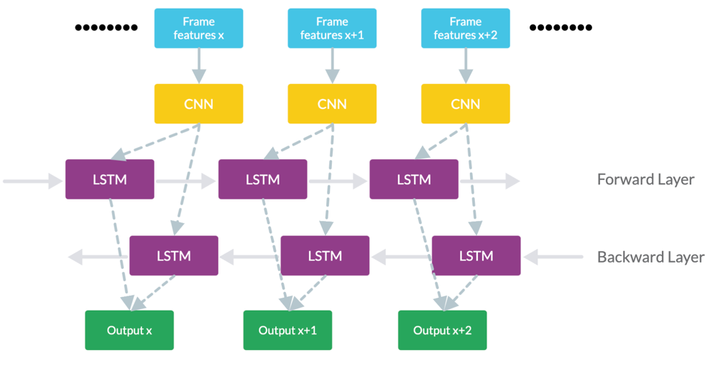
Model
Overall Architecture
Optimizer: Adam
Loss function: Cross-entropy loss
Introduction | Performance Analysis | Emotion Analysis | Piece Analysis | Web Application | Conclusion

Slide 35
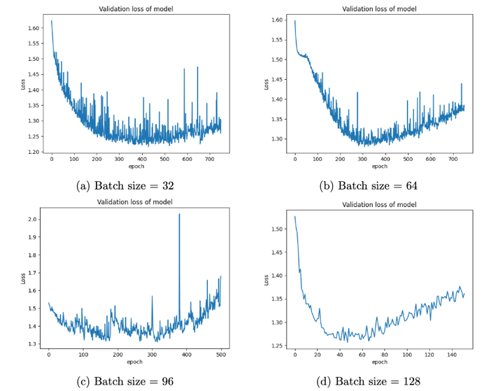
Results
Hyperparameters tuning
Batch Size: 32, 64, 96, 128
Batch size | Accuracy
32 | 50.07%
64 | 49.34%
96 | 44.58%
128 | 45.71%
Introduction | Performance Analysis | Emotion Analysis | Piece Analysis | Web Application | Conclusion

Slide 36
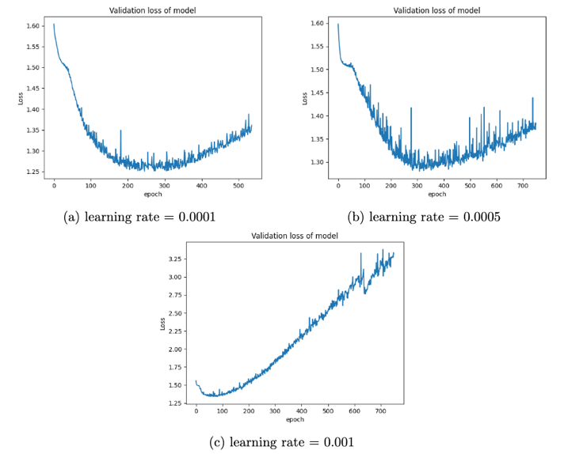
Results
Hyperparameters tuning
Learning rate: 0.0001, 0.0005, 0.001
Learning rate | Accuracy
0.0001 | 54.19%
0.0005 | 49.34%
0.001 | 40.46%
Introduction | Performance Analysis | Emotion Analysis | Piece Analysis | Web Application | Conclusion

Slide 37
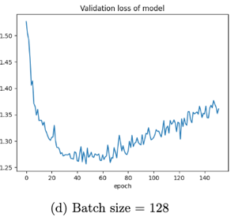
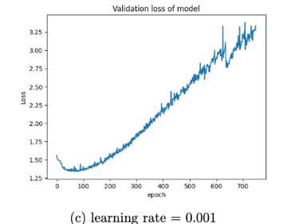
Results
Best configuration and result
The model tends to overfit due to larger batch size and higher learning rate
Batch size: 32, 64, 96, 128
Learning rate: 0.0001, 0.0005, 0.001
Top-1 accuracy: 57%
Introduction | Performance Analysis | Emotion Analysis | Piece Analysis | Web Application | Conclusion

Slide 38
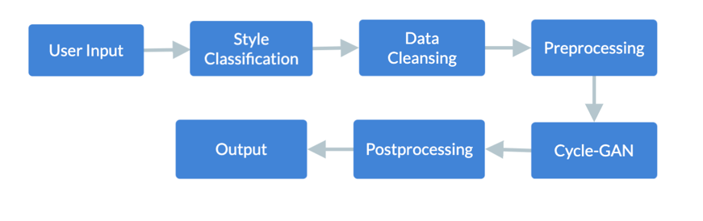
Style Transfer
Purpose
Transfer the style of the audio from one era to another era using generative AI model
Explore the possibility of style transfer in music era as no work has been done before
Flow Chart of Style transfer function
Introduction | Performance Analysis | Emotion Analysis | Piece Analysis | Web Application | Conclusion

Slide 39
Dataset
Music era | Time range | Number of data
Baroque | 1600-1730 | 619
Classical | 1731-1815 | 786
Romantic | 1816-1890 | 3365
Modern | 1891-1975 | 2926
Dataset description
Giant-MIDI Piano [7]
10,855 MIDI files of 2,786 composers
CSV file describing information of composers
Data labeling
Reformatted the data according to the year of thirty years old of each composer
Label the data by the range of certain music era
Introduction | Performance Analysis | Emotion Analysis | Piece Analysis | Web Application | Conclusion

Slide 40
Dataset
Dataset preprocessing [8]
Sampling rate of 16 timestamps per bar → sixteenth notes only
Limit the pitch range to facilitate training (C1 to C8)
Combine four bars into one data to preserve temporal structure → 64 time stamps
64 (time stamps) x 84 (pitch class) array
Clean the noisy data that their first beat does not start at 0
Data size for each class
Baroque: 19269, Classical: 47810, Romantic: 83913, Modern: 79281
Introduction | Performance Analysis | Emotion Analysis | Piece Analysis | Web Application | Conclusion

Slide 41
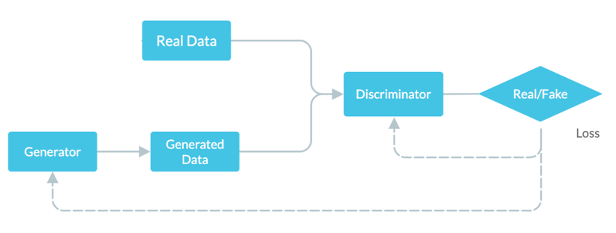
Model
Generative Adversarial Network (GAN) [9]
Generator tries to generate the best fake data
Discriminator tries to identify the fake data
Both generator and discriminator are composed of convolutional layers
Improving performance by losses from generator and discriminator
Architecture of GAN
Introduction | Performance Analysis | Emotion Analysis | Piece Analysis | Web Application | Conclusion

Slide 42
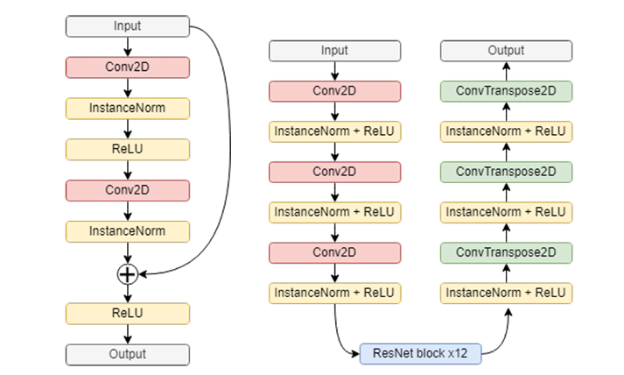
Model
Generator
Composed by convolutional layers and 12 ResNet blocks with different kernel size
Architecture of ResNet Block
Architecture of Generator
Introduction | Performance Analysis | Emotion Analysis | Piece Analysis | Web Application | Conclusion

Slide 43
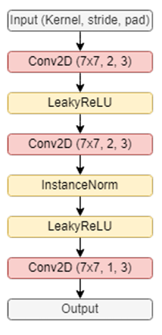
Model
Discriminator
Simple convolutional layers, with additional noise to prevent overpowering
Architecture of Discriminator
Introduction | Performance Analysis | Emotion Analysis | Piece Analysis | Web Application | Conclusion

Slide 44
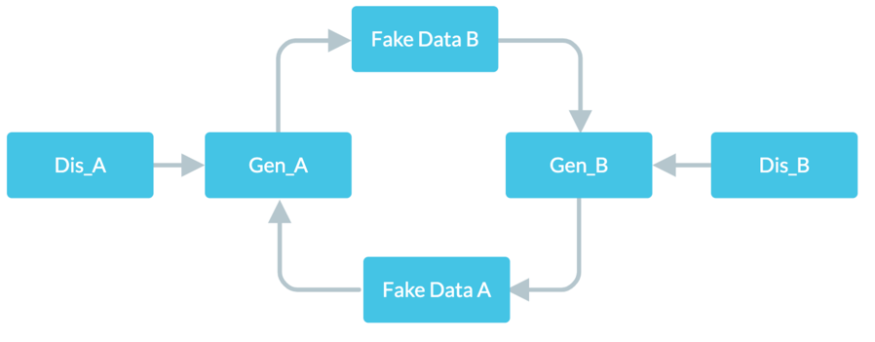
Model
CycleGAN [10]
Composed of a pair of generators and a pair of discriminators
Generator A: style A to style B , Generator B: style B to style A
Discriminator A: Classify data A, Discriminator B: Classify data B
Architecture of CycleGAN
Introduction | Performance Analysis | Emotion Analysis | Piece Analysis | Web Application | Conclusion

Slide 45
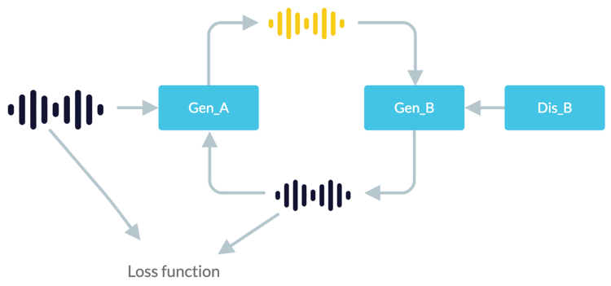
Model
Loss function
Cycle Consistency Loss [10] → Computed by comparing original input and output after a cycle
Generator loss: Generator A loss + Generator B loss + Cycle Consistency Loss
Discriminator loss: Discriminator A loss + Discriminator B loss
Cycle Consistency Loss
Introduction | Performance Analysis | Emotion Analysis | Piece Analysis | Web Application | Conclusion

Slide 46
Results
Model Training
One to one training due to the nature of CycleGAN → totaling 6 models
Down-sample the larger class size to the smaller one
Class to class | Generator Loss
Baroque to Classical | 1.79
Baroque to Romantic | 1.99
Baroque to Modern | 1.37
Classical to Romantic | 1.96
Classical to Modern | 2.36
Romantic to Modern | 3.07
Introduction | Performance Analysis | Emotion Analysis | Piece Analysis | Web Application | Conclusion

Slide 47
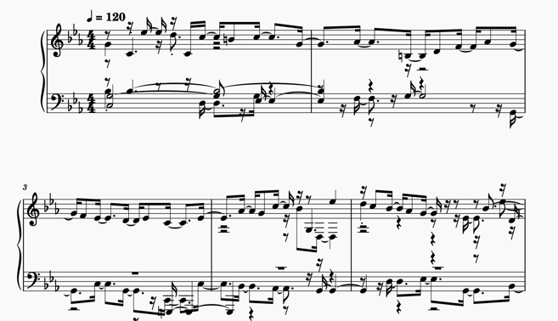

Results
Minuet in D Minor
Original
(Baroque)
Transferred
(Modern)
Introduction | Performance Analysis | Emotion Analysis | Piece Analysis | Web Application | Conclusion
Notes:
can show both before and after (this piece ionly is ok)

Slide 48
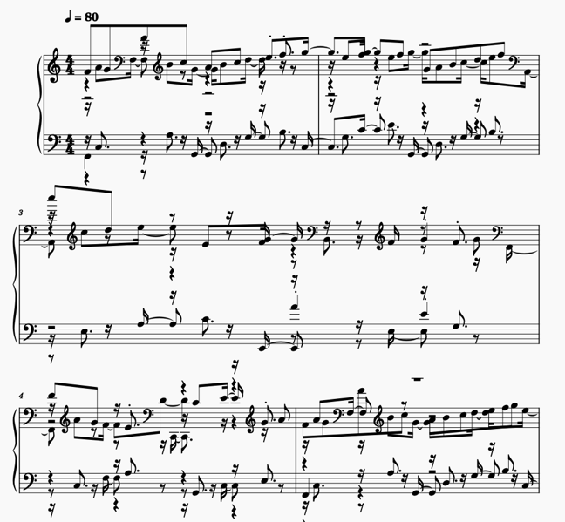

Results
Canon in D to Modern Style
Introduction | Performance Analysis | Emotion Analysis | Piece Analysis | Web Application | Conclusion

Slide 49

Piano Fingering Generation
sequence of notes
→ piano fingerings
Left/Right Note Sequence
Feature Extraction
Piano Fingerings
Data Preprocessing
Deep Learning Model
Fingerings
Dataset: Piano Fingering Dataset [11]
Methodology: combination of feature extraction & LSTM (by Guan et al. [12])
Introduction | Performance Analysis | Emotion Analysis | Piece Analysis | Web Application | Conclusion
Notes:
need mention which part is old, which part is new (verbally)
- add dataset

Slide 50
Feature Extraction
Used by Guan et al. [13]
Note Distance
Prev & Current Key Color
pitch_number[i] – pitch_number[i-1]
→ horizontal distance
previous & current key color (black / white)
→ vertical distance (depth, height)
monophonic only → add chords fingerings with heuristic rules
Motivation
polyphonic model
transition duration affects decision
Onset Time Difference
onset_time[i] – onset_time[i-1]
fingering unaffected by time-shifting
→ generalize time information
Introduction | Performance Analysis | Emotion Analysis | Piece Analysis | Web Application | Conclusion

Slide 51
Data Preprocessing
separate into two note sequences
flip left hand note distance (left-right symmetry)
→ treat the sequences equally
Unify L/R Fingering
note difference
clip to (-12, +12) (one octave)
normalize to (0, 1)
Normalize Feature
Pad Sequence
pad sequences to equal length (128)
(cut into segments of 128 during inference
Introduction | Performance Analysis | Emotion Analysis | Piece Analysis | Web Application | Conclusion
Notes:
morph methodology (new graphic)

Slide 52
Model
Input Layer (32 * 128 * 4)
batch size * sequence length * number of features
Masking
Bidirectional LSTM (1024)
LSTM: sequence processing
Bidirectional: simulate pianists making decisions based on future notes
more complex data → increased model size
Bidirectional LSTM (512)
Time-distributed Dense (128)
Time-distributed Dense (5)
probability for each class (softmax activation)
Loss Function: Cross Entropy Loss
Introduction | Performance Analysis | Emotion Analysis | Piece Analysis | Web Application | Conclusion

Slide 53

Results
longer sequence yield poorer results
key color feature does not contribute much
metric is strict (there may be multiple feasible values for the same set of notes)
Introduction | Performance Analysis | Emotion Analysis | Piece Analysis | Web Application | Conclusion
Notes:
result table
- highlight best model

Slide 54

Results
Suggestions on piece generated by style transfer
not perfect but feasible
fingering order is generally satisfied (no finger crossing)
Introduction | Performance Analysis | Emotion Analysis | Piece Analysis | Web Application | Conclusion
Notes:
highlight how good

Slide 55
05.
Web Application

Slide 56

Changes
Python GUI
Web Application
Frontend (React.js)
API Server (Node.js + Express)
MongoDB (numeric/text data)
Server Storage (multimedia)
Analysis Component (Python)
Introduction | Performance Analysis | Emotion Analysis | Piece Analysis | Web Application | Conclusion
Notes:
compare result with other’s work

Slide 57
Architecture
MongoDB (numeric/text data)
Retrieve
Create
Update
GET Request
Trigger
Frontend (React.js)
API Server (Node.js + Express)
Analysis Component (Python)
POST Request
POST Request
Reload
Store Media
Retrieve Media
Retrieve Media & Results
Store Results
Server Storage (multimedia)
Introduction | Performance Analysis | Emotion Analysis | Piece Analysis | Web Application | Conclusion
Notes:
compare result with other’s work

Slide 58
Pages Overview
Smart Music Teacher
Homepage
Performance Analysis
Emotion Analysis
Piece Analysis
Piece Overview
Recording Overview
Recording Playback
Introduction | Performance Analysis | Emotion Analysis | Piece Analysis | Web Application | Conclusion
Notes:
compare result with other’s work

Slide 59

Demo Video
Notes:
1. select model type
2. python .\code\rf_inference.py

Slide 60

Notes:
demo video

Slide 61
06.
Conclusion

Slide 62
Conclusion
Web Application
Performance Analysis
Emotion Analysis
Piece Analysis
Piano Practice Video
Music Video/Audio
Piano Piece
Performance Transcription
Valence-Arousal Analysis
Music Era Classification
Musical Analysis
Music Era Transfer
Metrics
Piano Fingering Suggestion
Complicated Musical Analysis → Understandable Metrics
Introduction | Performance Analysis | Emotion Analysis | Piece Analysis | Web Application | Conclusion
Notes:
built a web app with these functions
displays the possibility of

Slide 63
Reference
[1] R. Parncutt, J. A. Sloboda, E. F. Clarke, M. Raekallio, and P. Desain, “An Ergonomic Model of Keyboard Fingering for Melodic Fragments,” Music Perception, vol. 14, pp. 341–382, 07 1997.
[2] M. Balliauw, D. Herremans, D. Palhazi Cuervo, and K. S¨orensen, “A variable neighborhood search algorithm to generate piano fingerings for polyphonic sheet music,” International Transactions in Operational Research, vol. 24, no. 3, pp. 509–535, 2017.
[3] L. Feldman Barrett and J. A. Russell, “Independence and bipolarity in the structure of current affect.,” Journal of personality and social psychology, vol. 74, no. 4, p. 967, 1998.
[4] R. Panda, R. Malheiro, and R. P. Paiva, “Novel audio features for music emotion recognition,” IEEE Transactions on Affective Computing, vol. 11, no. 4, pp. 614–626, 2018. [5] R. Panda, R. Malheiro, and R. P. Paiva, “Musical texture and expressivity features for music emotion recognition,” in 19th International Society for Music Information Retrieval Conference (ISMIR 2018), pp. 383–391, 2018.
[6] C. Weiß, M. Mauch, S. Dixon, and M. M ̈uller, “Investigating style evolution of Western classical music: A computational approach,” Musicae Scientiae, vol. 23, no. 4, pp. 486–507, 2019.
[7] Q. Kong, B. Li, J. Chen, and Y. Wang, “Giantmidi-piano: A large-scale midi dataset for classical piano music,” 2022.

Slide 64
Reference
[8] G. Brunner, Y. Wang, R. Wattenhofer, and S. Zhao, “Symbolic music genre transfer with cyclegan,” in 2018 IEEE 30th International Conference on Tools with Artificial Intelligence (ICTAI), pp. 786–793, 2018.
[9] I. Goodfellow, J. Pouget-Abadie, M. Mirza, B. Xu, D. Warde-Farley, S. Ozair, A. Courville, and Y. Bengio, “Generative adversarial nets,” in Advances in Neural Information Processing Systems (Z. Ghahramani, M. Welling, C. Cortes, N. Lawrence, and K. Weinberger, eds.), vol. 27, Curran Associates, Inc., 2014.
[10] J.-Y. Zhu, T. Park, P. Isola, and A. A. Efros, “Unpaired image-to-image translation using cycle-consistent adversarial networks,” in Proceedings of the IEEE International Conference on Computer Vision (ICCV), Oct 2017.
[11] E. Nakamura, Y. Saito, and K. Yoshii, “Statistical learning and estimation of piano fingering,” Information Sciences, vol. 517, pp. 68–85, 2020.
[12] H. Guan, Z. Yan, and T. Hsu, “Automatic piano fingerings estimation using recurrent neural networks,” 11 2021.

Slide 65
Q&A
Notes:
1. select model type
2. python .\code\rf_inference.py

Slide 66

Sustaining note
Note Onset profile
Introduction | Performance Analysis | Emotion Analysis | Piece Analysis | Web Application | Conclusion
Notes:
built a web app with these functions
displays the possibility of

Slide 67
Appendix Web App Pages
Notes:
will include in print

Slide 68

Homepage

Slide 69

Piece Overview

Slide 70

Recording Overview

Slide 71


Recording Overview (Metrics)

Slide 72


Recording Overview (Metrics)

Slide 73

Recording Playback

Slide 74


Emotion Analysis

Slide 75


Piece Analysis

